Slide 1
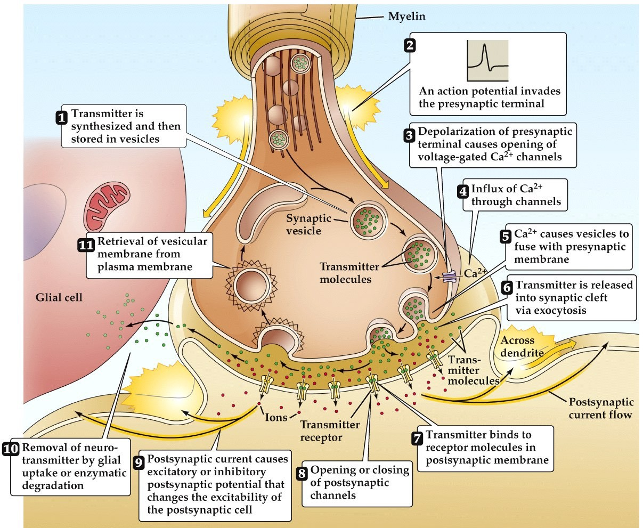
Steps 6-8
Neurotransmitters are released into the synaptic cleft (exocytosis)
Neurotransmitters bind to receptor molecules in the postsynaptic membrane.
Opening or closing of postsynaptic channels

Slide 2
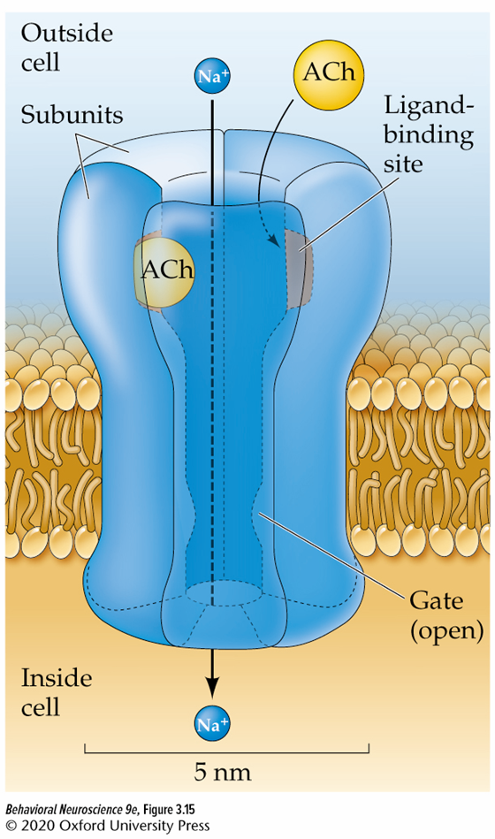
Receptors on the Post-synaptic membrane determine the action of the neurotransmitter
Only certain neurotransmitters can bind with certain receptors, like a lock and key.
Main types:
  Ionotropic
  Metabotropic

Slide 3
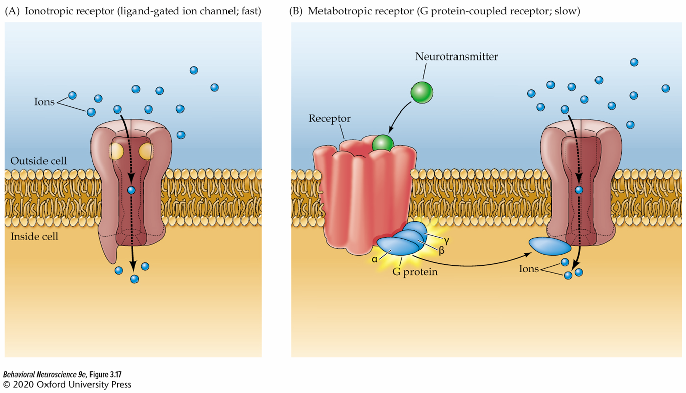
Ionotropic receptors
Chemically/ligand gated ion channels
Direct control over an ion channel
“Fast” transmission

Slide 4
Metabotropic receptors
Indirect control over ion channels and other cellular processes
AKA G-protein coupled receptors
“slow” transmission

Slide 5
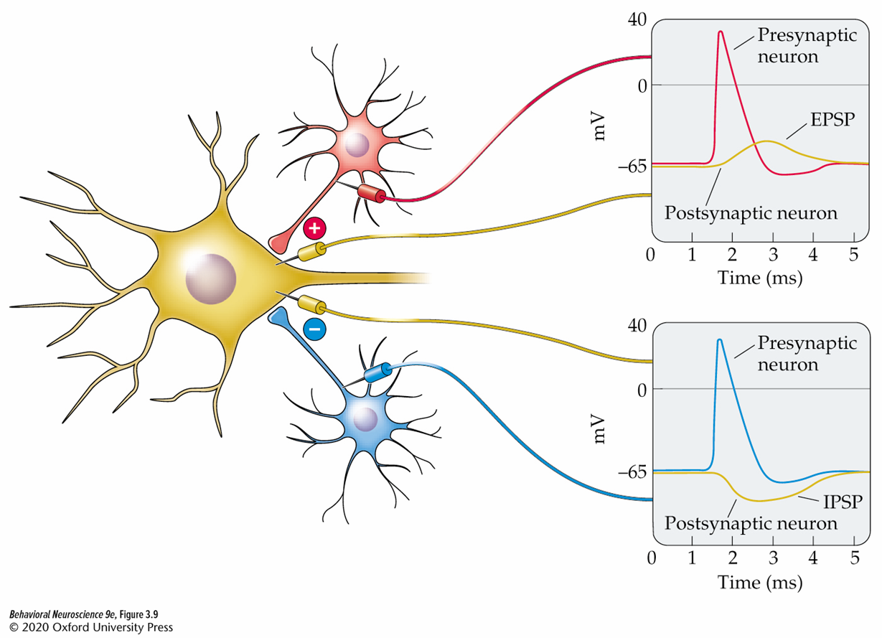
Step 9: Postsynaptic potentials
Excitatory post-synaptic potential (EPSP) : makes the environment inside the cell more positive
Inhibitory post-synaptic potential (IPSP) : makes the environment inside the cell more negative

Slide 6
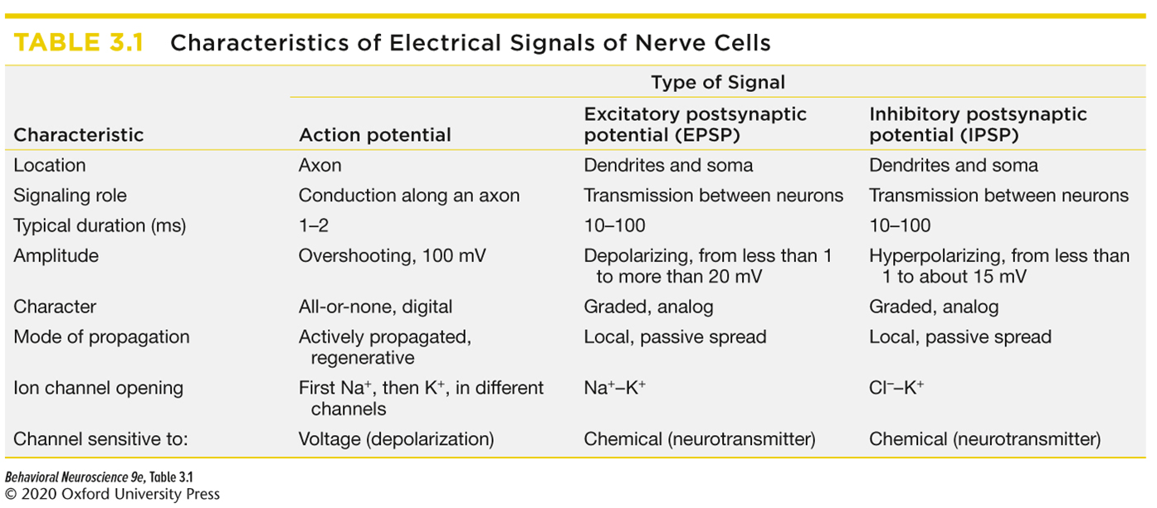
Differences between the Action potential and post-synaptic potentials

Slide 7
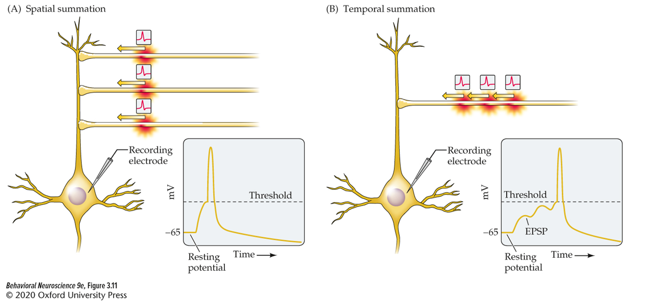
Influences on PSP power:
Spatial summation
Post-synaptic potentials physically close to the cell body will have better summed power than post-synaptic potentials originating farther away.

Slide 8
Influences on PSP power: Temporal Summation
Post-synaptic potentials close together in timing will have better summed effect than post-synaptic potentials spaced out in time.

Slide 9
Steps 10: Removal of Neurotransmitters
Neurotransmitters in the synaptic cleft can:
  Be destroyed by enzymes
  Diffuse out of the synaptic cleft
    Could bind with an autoreceptor
    Could be absorbed by glial cells
  Be removed by pre-synaptic transporter proteins and recycled

Slide 10
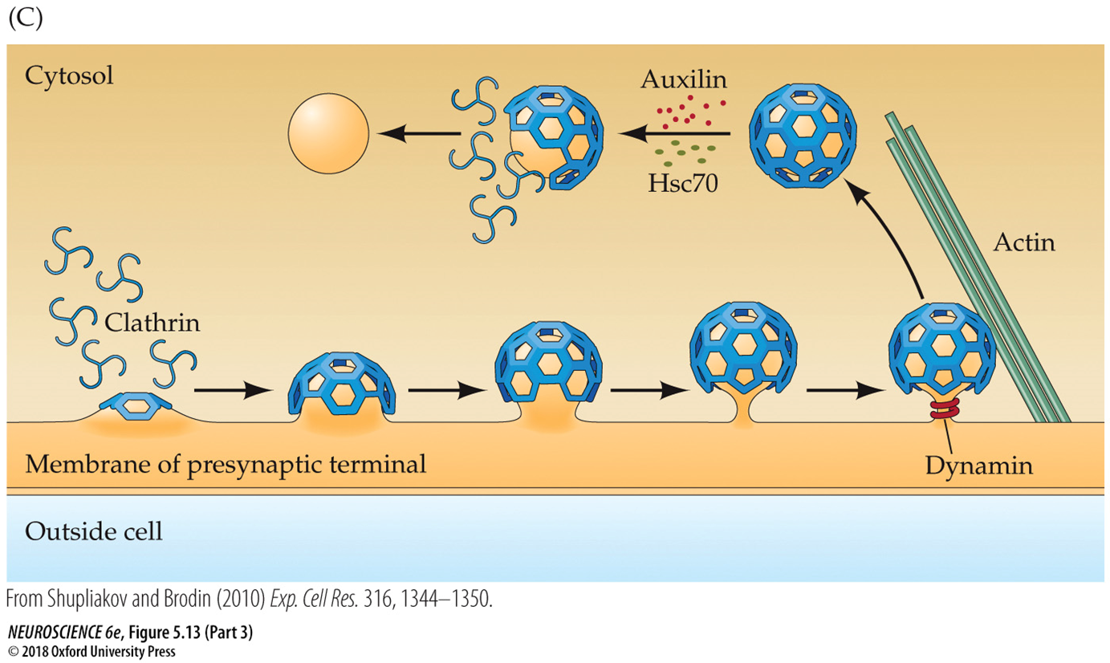
A closer look at reuptake (endocytosis)

Slide 11
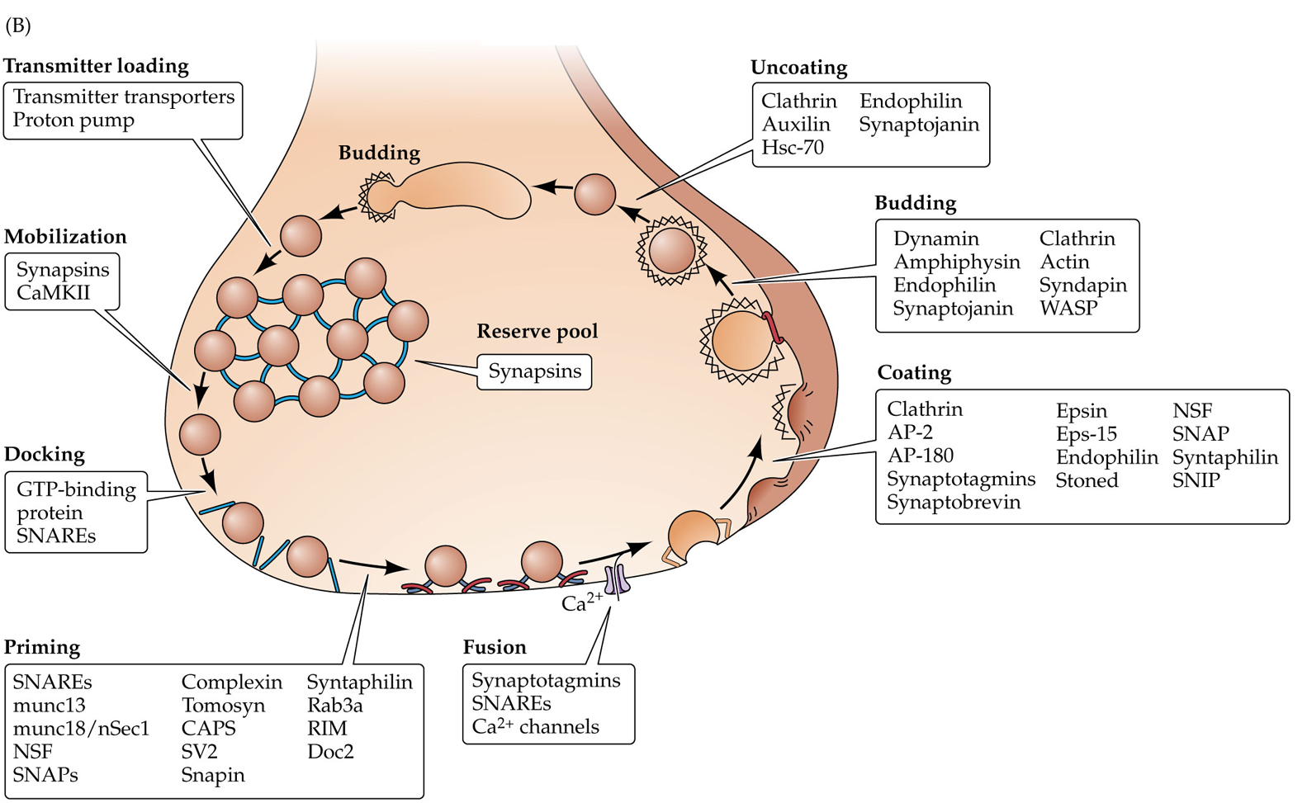
Vesicle Trafficking cycle

Slide 12
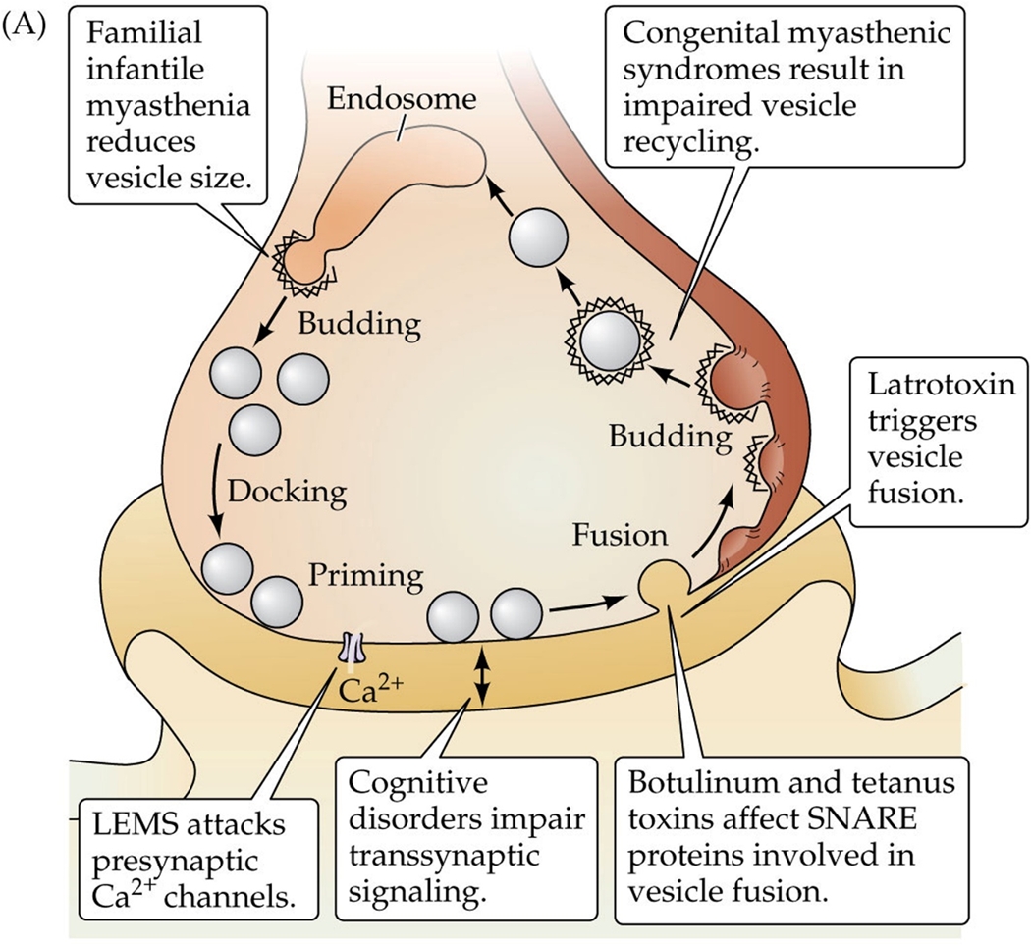
Disorders at the synapse
Myasthenic syndromes
  abnormal transmission at NMJ leading to weakness and fatigue of skeletal muscles
Botulism
  caused by a Clostridium botulinum toxin, can impair NT release at NMJs leading to flaccid paralysis
Tetanus
  Caused by Clostridum tetani toxin, can impair inhibitory control of primary motor neurons leading to spastic paralysis
α-latrotoxin (α-LTX)
  from black widow spider venom induces exhaustive release of neurotransmitters from vertebrate nerve terminals. Causes muscle cramping and difficulty breathing

Slide 13
Summary
Neurotransmitters released into the synaptic cleft can bind with specific receptors on the post-synaptic membrane.
The action of a NT depends on activation of a receptor
Ionotropic receptors have direct control over an ion channel whereas metabotropic receptors have secondary cellular mechanisms that can influence several processes in the post-synaptic cell.
Post-synaptic potentials can be excitatory or inhibitory.
The power of post-synaptic potentials degrades over time and space.
NTs are removed from the synapse through degradation, reuptake, or diffusion.
Endocytosis is the process by which vesicles are recycled from the presynaptic membrane.
There are several clinical conditions that alter events at the synapse resulting in impairments of bodily functions, especially those involving muscles.

